Slide 1
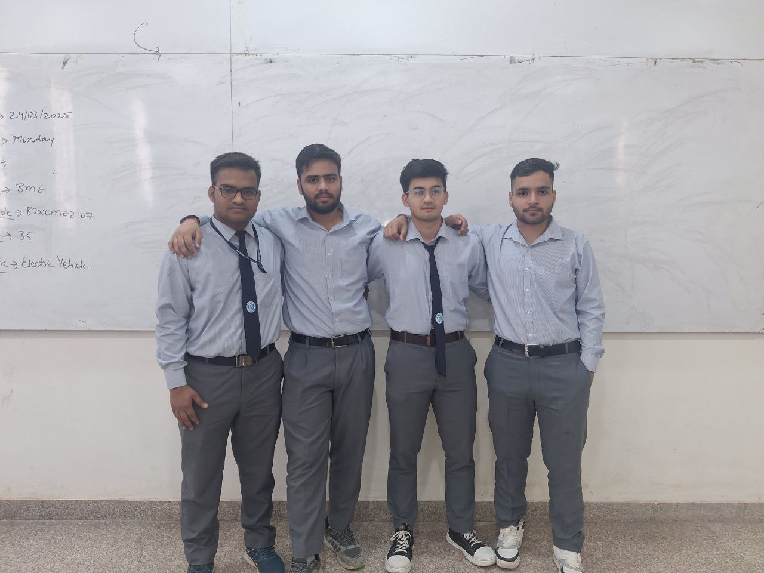

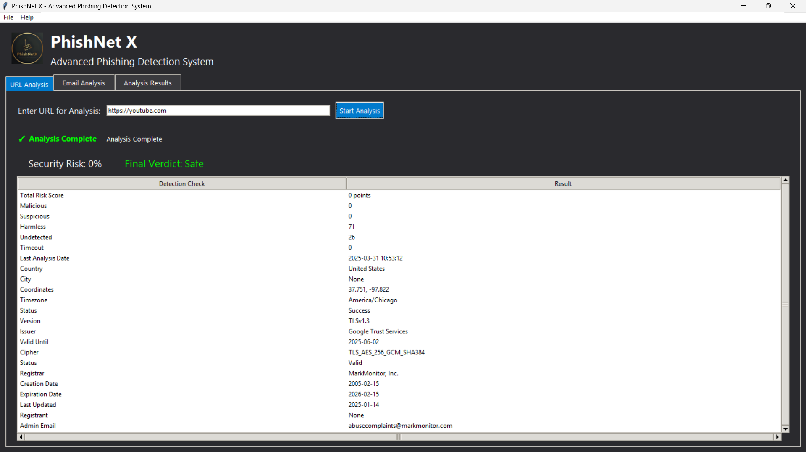
FACULTY OF COMPUTER SCIENCE & ENGINEERING
PHISHNET X – Phishing Email and Website Detection
OBJECTIVE
MODEL / PROJECT DIAGRAM/ GUI / FLOWCHART ETC.
Develop PhishNet X, a robust phishing detection system.
Provide a user-friendly interface for streamlined threat analysis.
Safeguard users from fraudulent URLs and phishing emails.
Enhance cybersecurity by minimizing risks from deceptive practices.
Promote proactive cybersecurity awareness among users
DETAILS OF INNOVATION
OUTCOME & FUTURE SCOPE
Employs multi-layered analysis combining heuristic checks, SSL/TLS validations, and DNS inspections
Integrates external APIs like VirusTotal and WHOIS for enriched threat intelligence.
Utilizes advanced techniques to validate URL structures and identify anomalies.
Offers an innovative approach to email analysis by scrutinizing sender authenticity and embedded URLs
Adopts a modular design for easy updates and scalability.
OUTCOMES:
Ensures early detection of phishing attempts to improve user safety.
Reduces cyber risks by accurately identifying fraudulent activities.
Simplifies complex threat analysis with an intuitive interface.
Contributes to robust cybersecurity standards across platforms.
FUTURE SCOPE:
Integrate real-time threat intelligence feeds for up-to-the-minute analysis.
Enhance detection capabilities using machine learning or deep learning and advanced pattern recognition.
Expand platform compatibility and achieving more accuracy
GUIDED BY : Mr. Abhishek Kumar Singh
Asst. Professor, FCE, PU
TEAM MEMBERS : Mohit Singh Papola (2024/18313)
Mandeep Singh (2024/17854)
Ankush Rana (2024/18312) Saurabh Rana (2024/16985)

